Slide 1


Using the automated building of computational models to understand cardiotoxic drug responses
Dr. Robert Sheehan
Sorger Lab
LSP Meeting
July 6, 2018

Slide 2
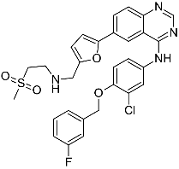
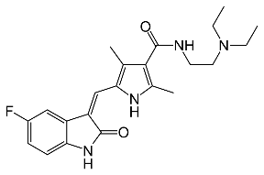
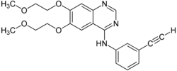
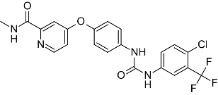
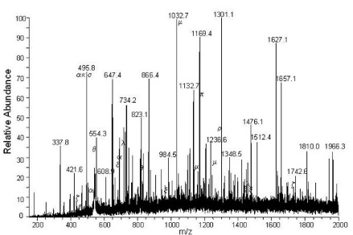
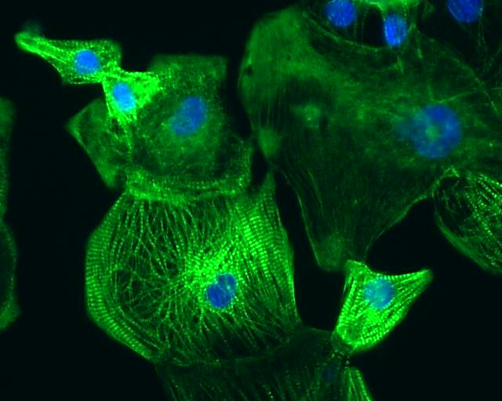
Developing signatures of Tyrosine Kinase Inhibitor response in cardiomyocytes
Measure at level of target and proximate signaling proteins
Mechanistic and causal
modeling and experiments
Measure at level of induced changes in gene and protein levels
Measure at level of phenotype
Courtesy of Huan Wang
50 µm

Slide 3
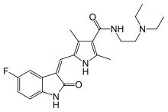
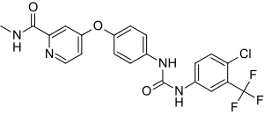
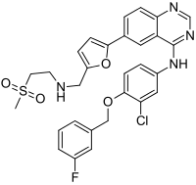
Four selected tyrosine kinase inhibitors
TKIs | Chemical structure | Putative target | Cmax (µM) | Dose/d (mg)
Sunitinib |  | VEGFR, PDGFR, CSF1R, FLT3, KIT | 0.03-0.12 | 50
Sorafenib |  | B-Raf, VEGFR, PDGFR, FLT3, KIT | 6-18 | 800
Lapatinib |  | EGFR, ERBB2 | 4.2 | 1250
Erlotinib |  | EGFR | 2.7-7.3 | 150
Courtesy of Huan Wang

Slide 4
Selecting best dose ranges and exposure times
Toxicity: mitochondrial membrane potential
Cell death: Cell titer glo
Normalization: nuclei #
DMSO Control
6h
24h
72h
7day
Sunitinib
1 μM
24h
Lapatinib
6h
72h
7day
3.2 μM
24h
Erlotinib
10 μM
24h
Sorafenib
RNAseq
Courtesy of Huan Wang
2-3 biological replicates per condition

Slide 5
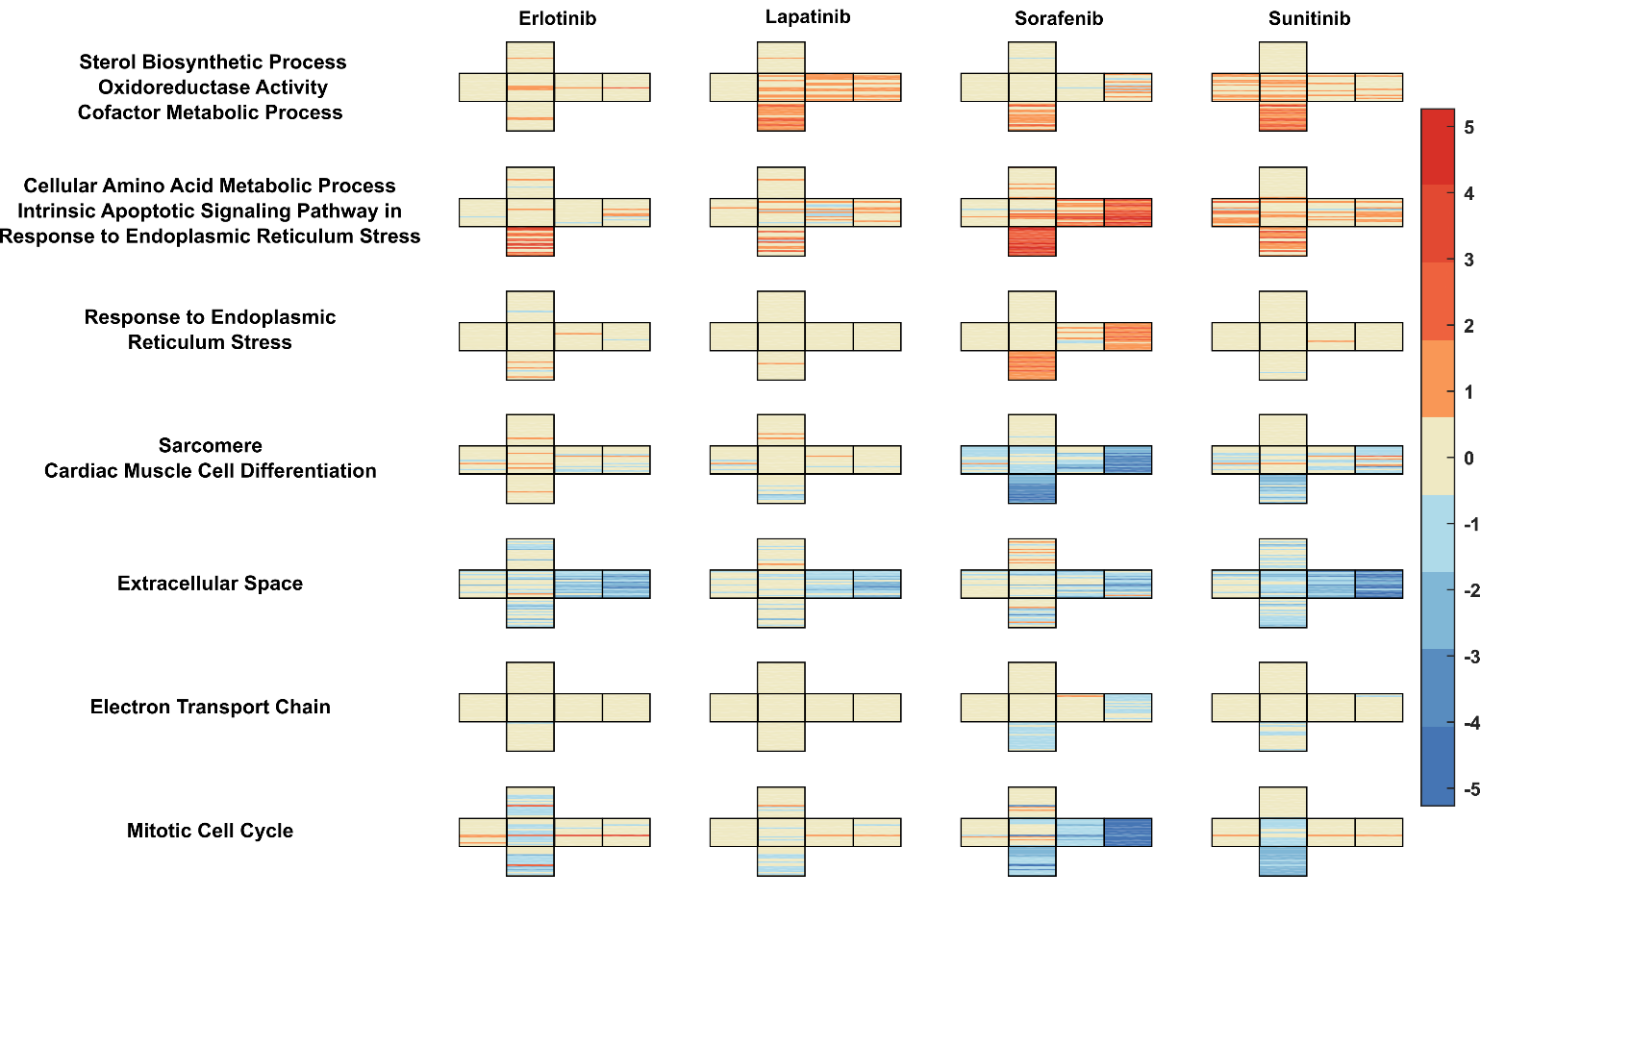
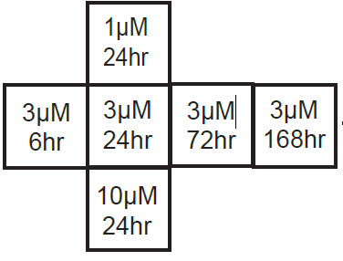
Clustering of RNA-Seq data highlights patterns of expression

Slide 6
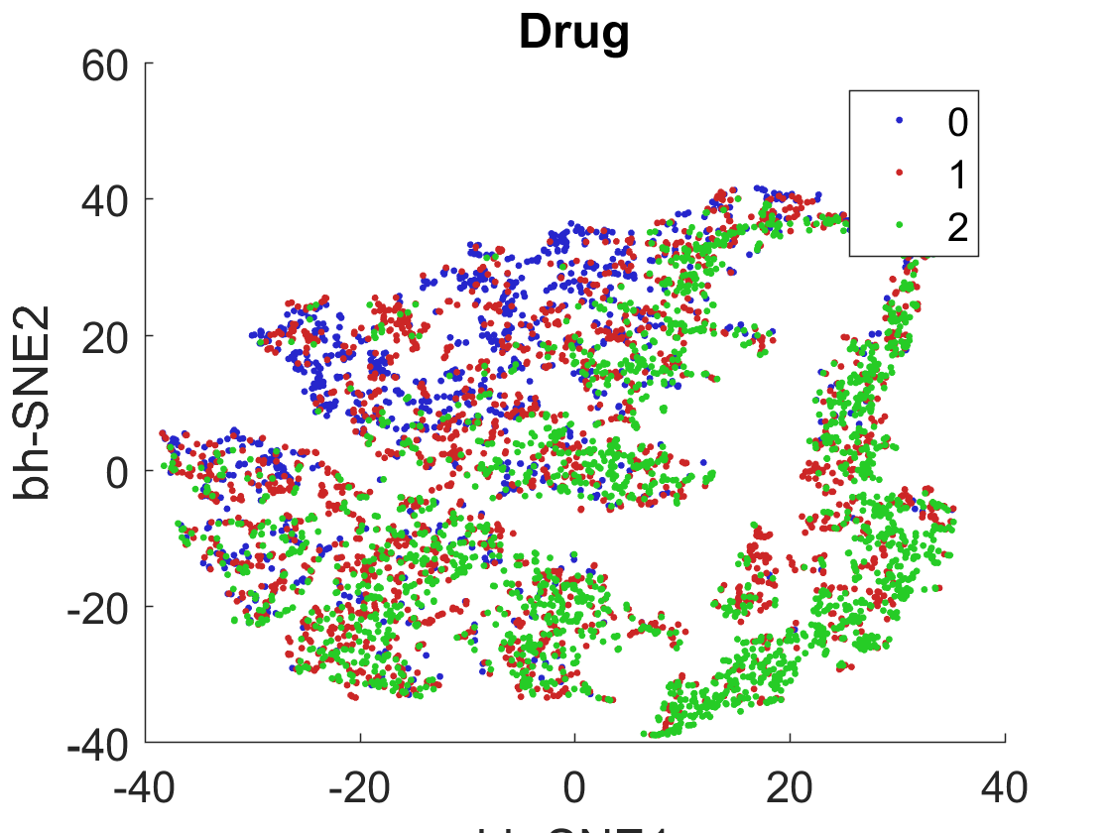
Additional experimental data: CycIF
Sunitinib and Sorafenib shift cell staining profile
9 drugs (including previous four)
3 doses
8 time points
4-5 cycles
5 antibody panels
DMSO
Sorafenib
Sunitinib
Connor Jacobson and Zoltan Maliga
Notes:
6

Slide 7
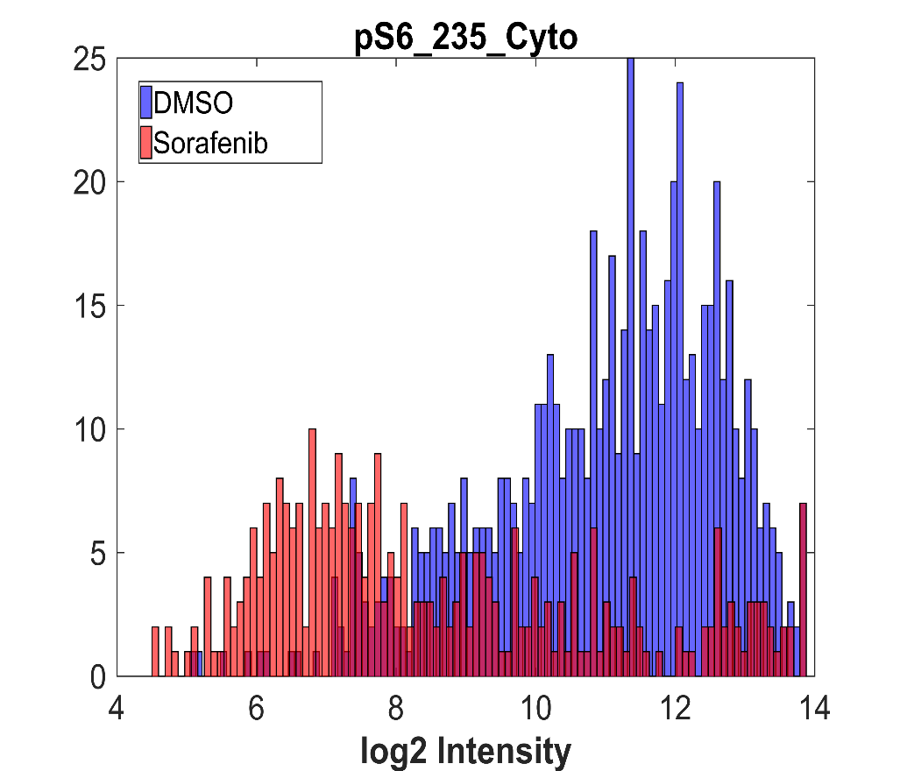
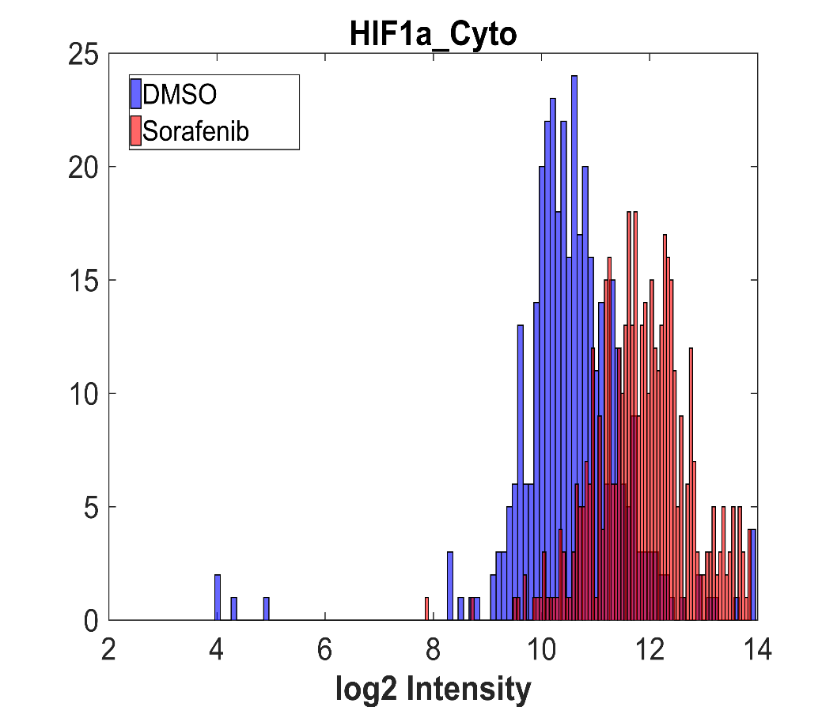
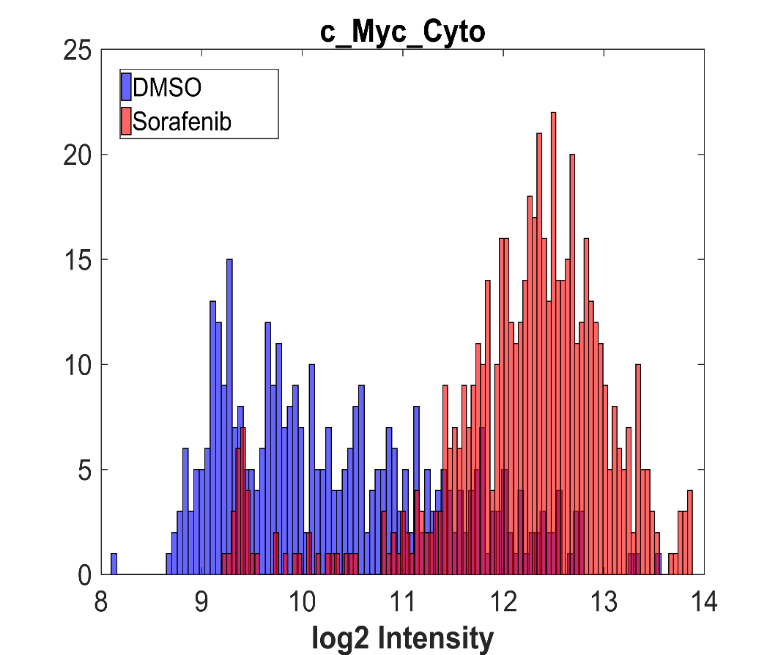
Identifying key changes following Sorafenib treatment
pPKM2_Cyto

Slide 8
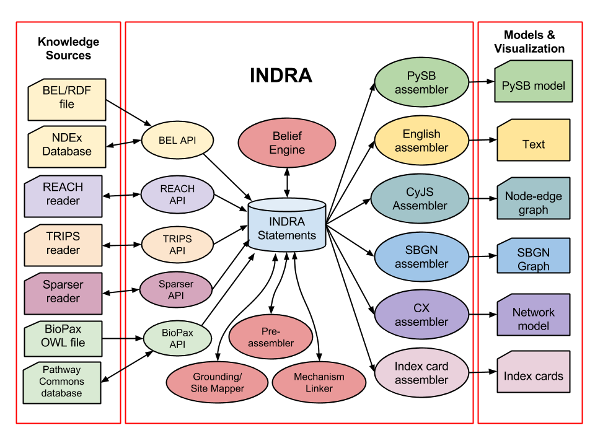
INDRA – Integrated Network and Dynamical Reasoning Assembler
https://github.com/sorgerlab/indra
Benjamin Gyori and John Bachman

Slide 9
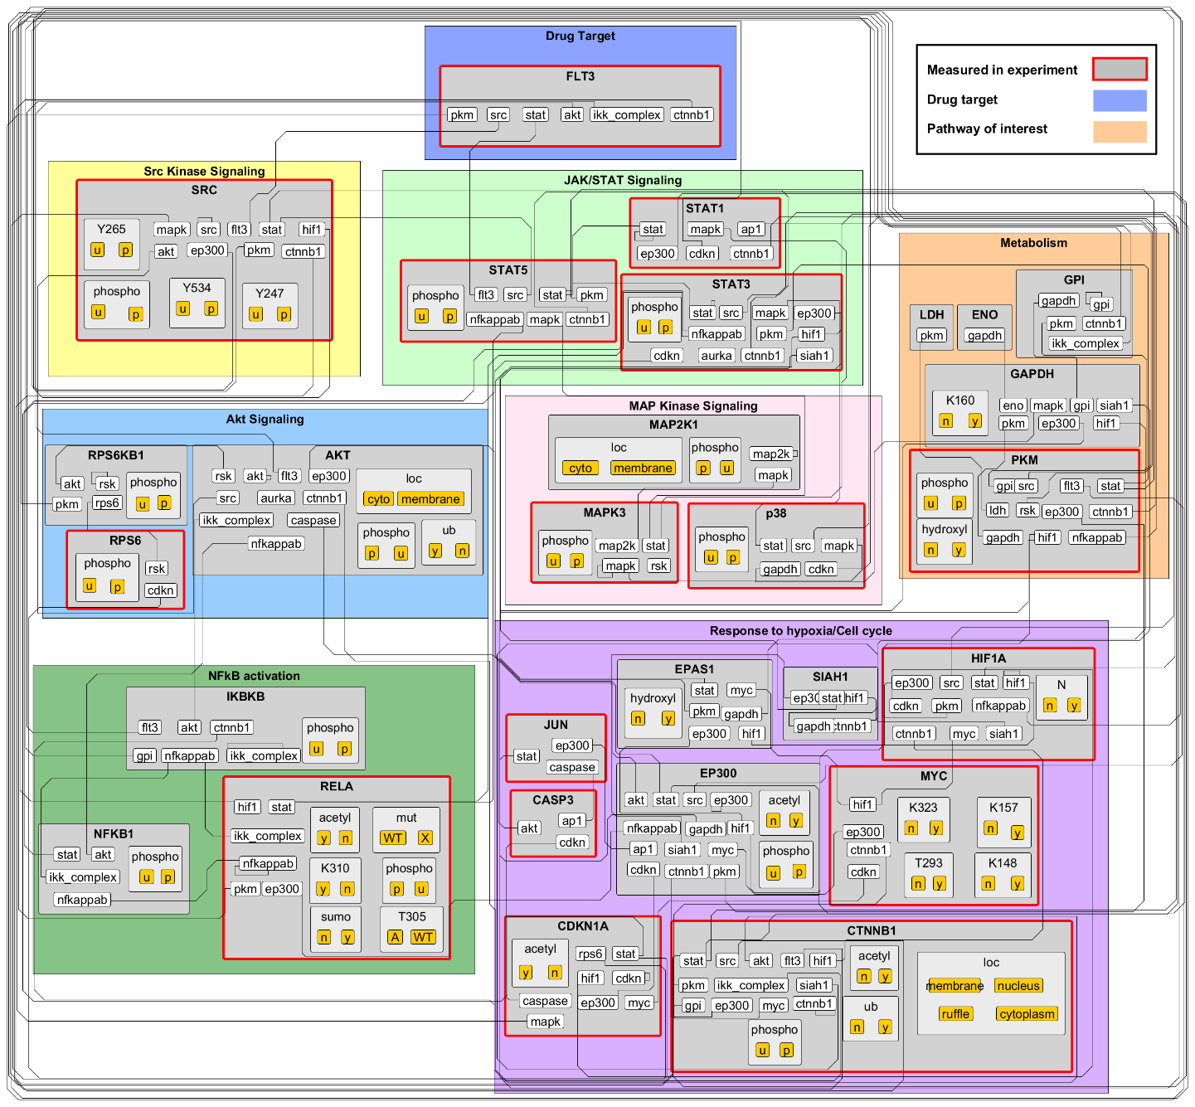
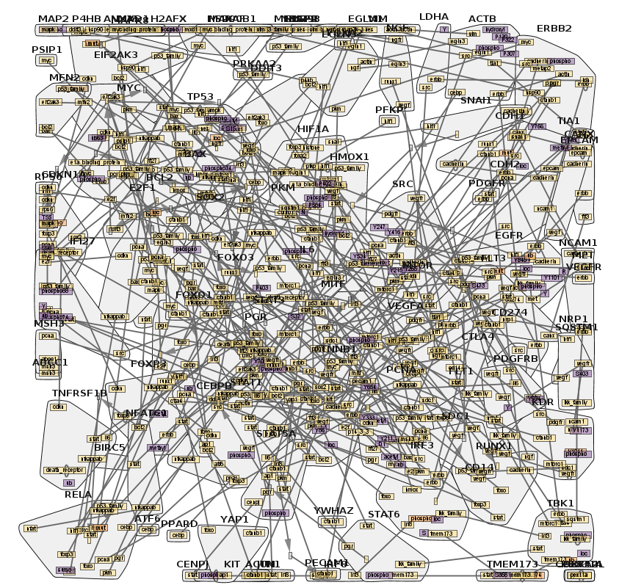
Using INDRA to build a model specific to this data set

Slide 10

Building a minimal model –
A bottom-up approach using INDRA DB and model checking
Drug Targets
Experimental Observations
Modeling outputs

Slide 11
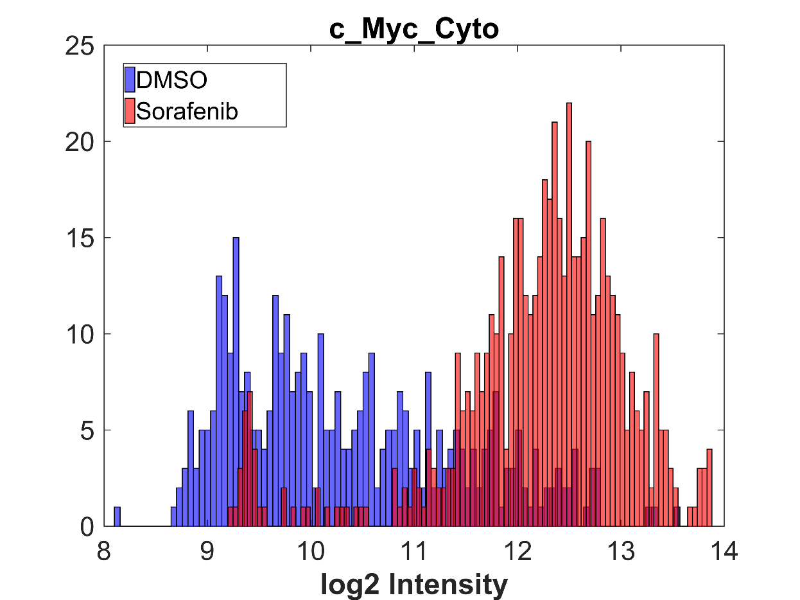
Building a minimal model –
A bottom-up approach using INDRA DB and model checking
Drug Targets
c-Myc Abundance
pPKM_Cyto
Experimental Observations
In our model, does Sorafenib treatment lead to a decrease in S6 phosphorylation?
If not, can we add something minimal to our model to allow this?
Modeling outputs

Slide 12
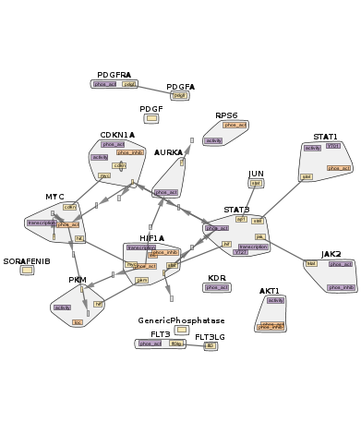
A large, manually selected model with all necessary nodes, may still not match our experimental results
Dephosphorylation(SORAFENIB(), RPS6()), path_found: False result_code: NO_PATHS_FOUND
IncreaseAmount(SORAFENIB(), HIF1A()), path_found: False result_code: NO_PATHS_FOUND
Phosphorylation(SORAFENIB(), PKM()), path_found: False result_code: OBSERVABLES_NOT_FOUND
Key mechanisms are missing from the model

Slide 13
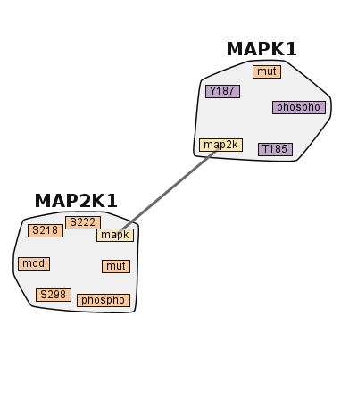
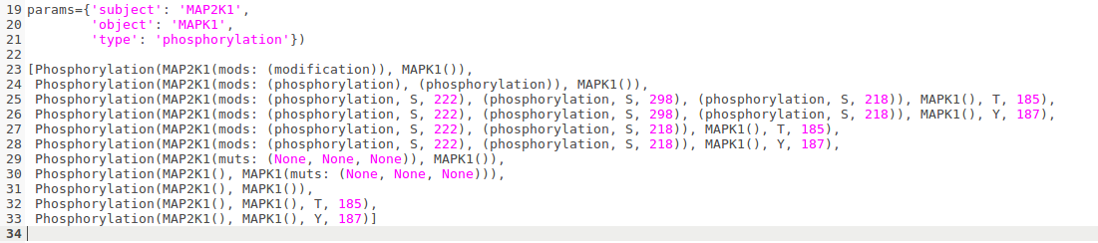
INDRA DB – Searching for mechanisms
Patrick Greene

Slide 14
DB helps explain our experimental results
Experimental observation
'Sorafenib dephosphorylates RPS6.
Goal: Build up necessary pathway
Search for relevant mechanisms:
What phosphorylates S6?
params={'object': 'RPS6', 'type': 'phosphorylation'})
[Phosphorylation(AKT1(), RPS6(), S, 473), Phosphorylation(BRAF(muts: (V, 600, E)), RPS6()), Phosphorylation(CAMKK2(), RPS6()), Phosphorylation(DAPK1(), RPS6()), Phosphorylation(EGFR(), RPS6()), Phosphorylation(FGFR2(), RPS6()), ... Phosphorylation(RPS6KA1(), RPS6(), S, 236), Phosphorylation(RPS6KA1(), RPS6(), S, 240), Phosphorylation(RPS6KB1(mods: (phosphorylation, T, 412), (phosphorylation, S, 394)), RPS6(), S, 236), Phosphorylation(RPS6KB1(mods: (phosphorylation, T, 412), (phosphorylation, S, 394)), RPS6(), S, 240), ...
A whole list of kinases

Slide 15
Selecting a kinase and extending the pathway
How is RPS6KB1 activated?
Phosphorylation
INDRA DB:
params={'object': 'RPS6KB1', 'type': 'activeform'})
[ActiveForm(RPS6KB1(mods: (phosphorylation, S, 394)), activity, True), …
So, how is RPS6KB1 phosphorylated?
Iterate to fill out the pathway
Kinases targeting s6k:
['PLK2', 'RPS6KA2', 'MAPK10', 'MKNK2', 'MAPK8', 'SRC', 'MAPKAPK5', 'ROS1', 'MAPK7', 'DAPK2', 'NEK6', 'EIF2AK3', 'ULK1', 'AKT1’ ….
What phosphorylates AKT1?
Kinases = … PDGFRA…
Sorafenib target

Slide 16
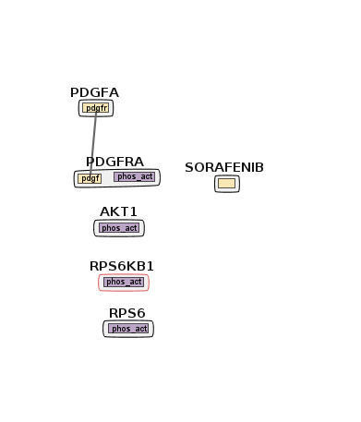
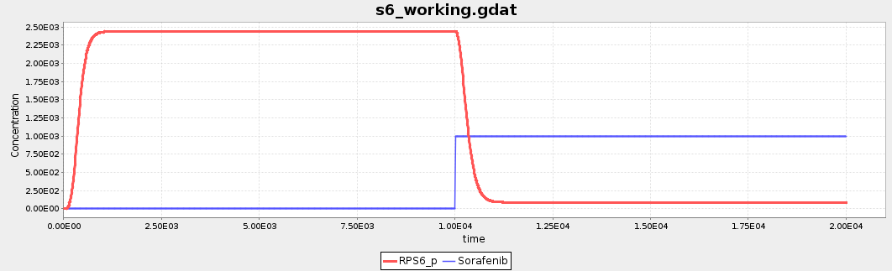
Our model now satisfies the desired condition
Connected target
PDGFRA
To experimental observarion
RPS6 phosphorylation
(Dephosphorylation(SORAFENIB(), RPS6()), PathResult: True
Sorafenib dephosphorylates PDGFRA
PDGFRA phosphorylates AKT
AKT phosphorylates S6K
S6K phosphorylate S6

Slide 17
Capturing important effects of Sorafenib in a model
Dephosphorylation(SORAFENIB(), RPS6()),
Phosphorylation(SORAFENIB(), PKM()),
IncreaseAmount(SORAFENIB(), HIF1A())
pPKM2_Cyto

Slide 18
Capturing important effects of Sorafenib in a model
Major Goal:
A single model that encompasses all key experimental observations
Keep model as small as possible
Automate where possible
Incorporate user-contributed biological knowledge otherwise
Dephosphorylation(SORAFENIB(), RPS6()),
Phosphorylation(SORAFENIB(), PKM()),
IncreaseAmount(SORAFENIB(), HIF1A())
pPKM2_Cyto

Slide 19
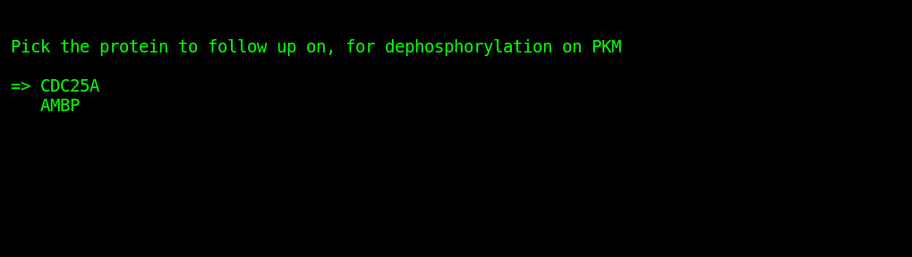
Iterate over model pathways and experimental data, guided by user input when necessary
Iteratively query database
First check to see if any option allows the model checker to pass
Pick this by default and exit
Helpful in efficiently finding the smallest model to satisfy constraints
If not, user decides what to add to the model
Guide system to pathway of interest
Explore different pathways

Slide 20
Three observables: all paths found!
Dephosphorylation(SORAFENIB(), RPS6()), PathResult: path_found: True result_code: PATHS_FOUND
Phosphorylation(SORAFENIB(), PKM()), PathResult: path_found: True result_code: PATHS_FOUND
IncreaseAmount(SORAFENIB(), HIF1A()), PathResult: path_found: True result_code: PATHS_FOUND
Sorafenib -> PDGFRA -> SRC -> RPS6
Sorafenib -> PDGFRA -> SRC -> CDC25A -> PKM2
Sorafenib -> PDGFRA -> SRC -> AKT -> FOXO4 -> HIF1a

Slide 21
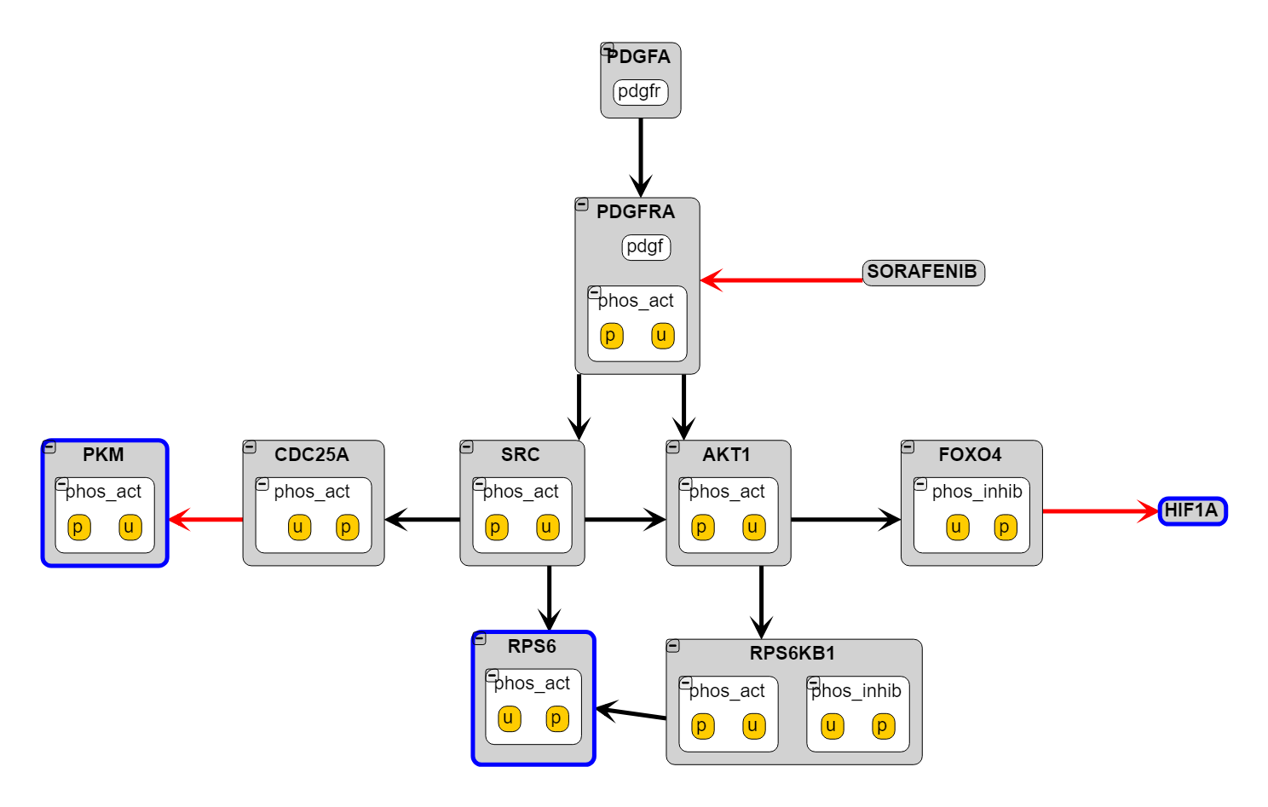
Final Model – very compact

Slide 22
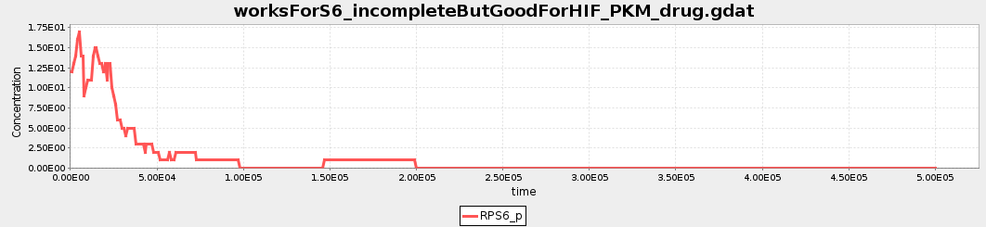
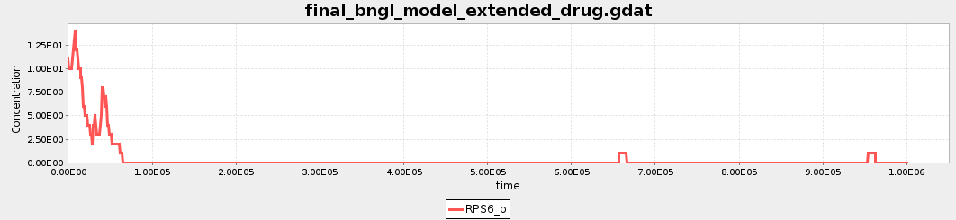
Simulations – S6 phosphorylation decreases

Slide 23
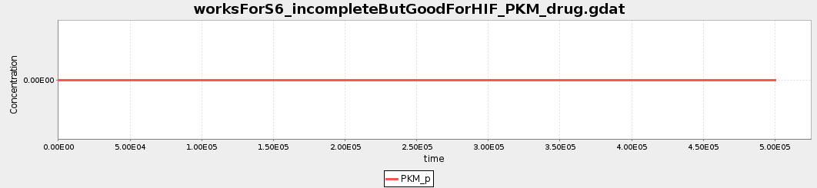
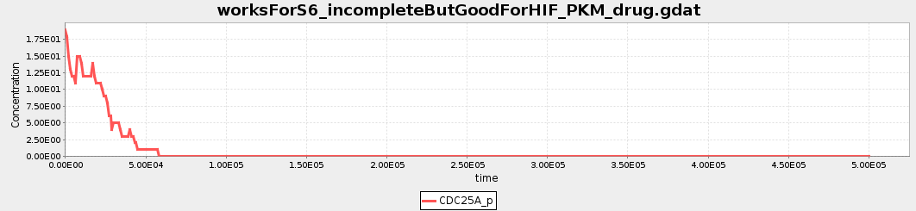
PKM phosphorylation doesn’t increase despite phosphatase inhibition

Slide 24
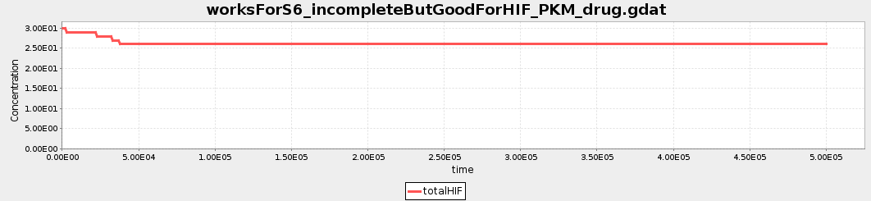
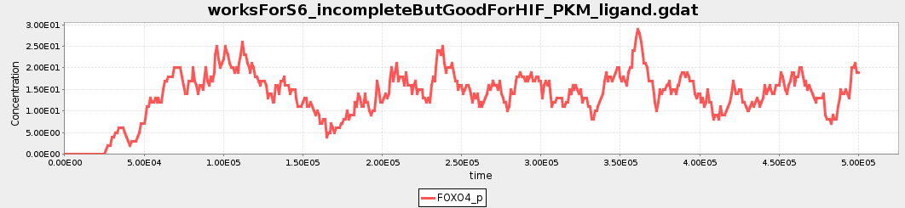
HIF1A doesn’t increase despite inhibited degradation – no transcription

Slide 25
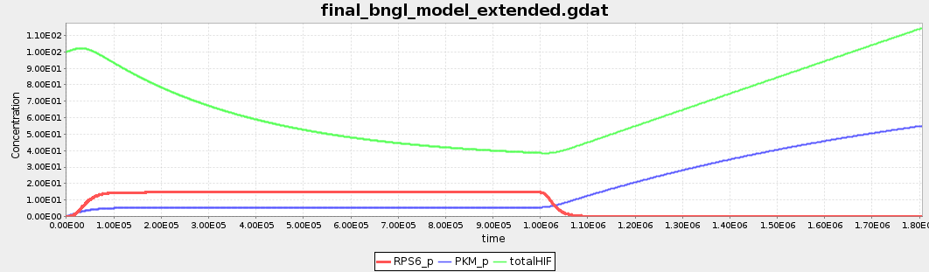
Add baseline phosphorylation and transcription – model works
Sorafenib Added
PKM phosphorylation
RPS6 phosphorylation
PKM phosphorylation
HIF1a Abundance

Slide 26
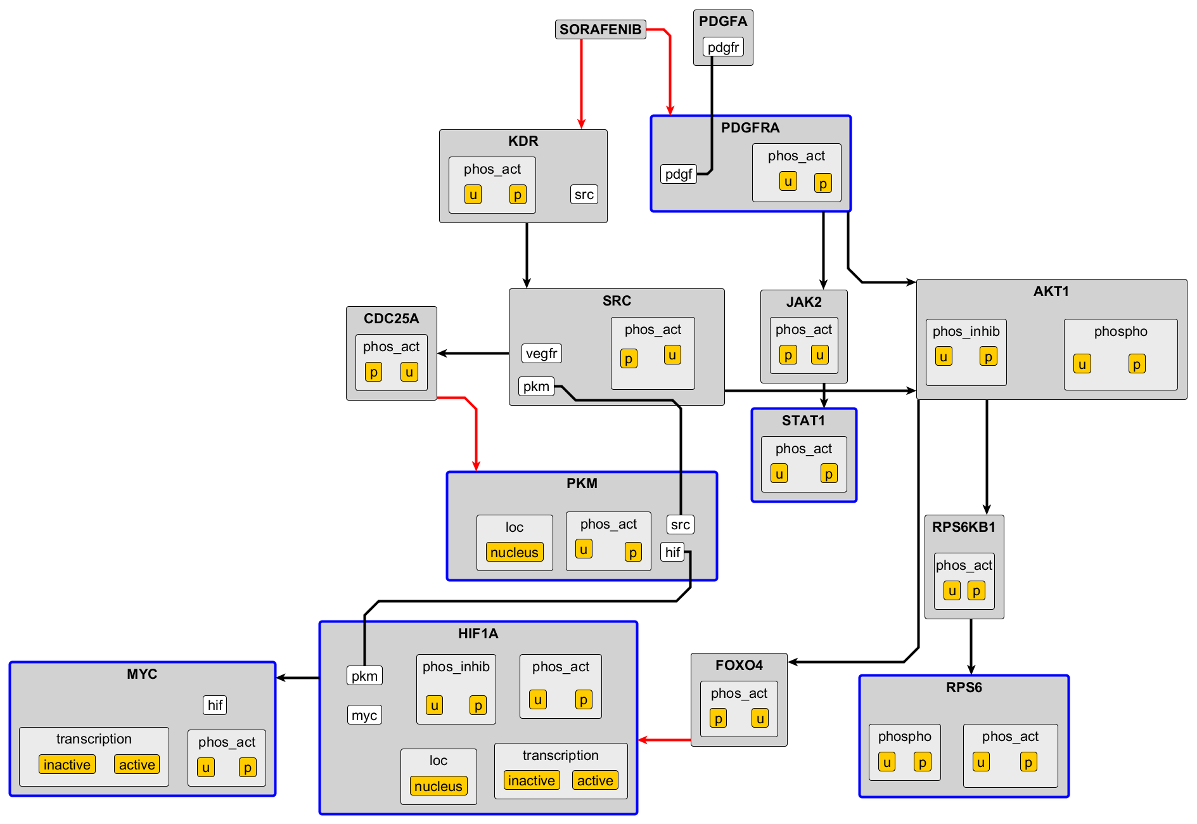
Extending to six experimental observables: Larger, still compact

Slide 27
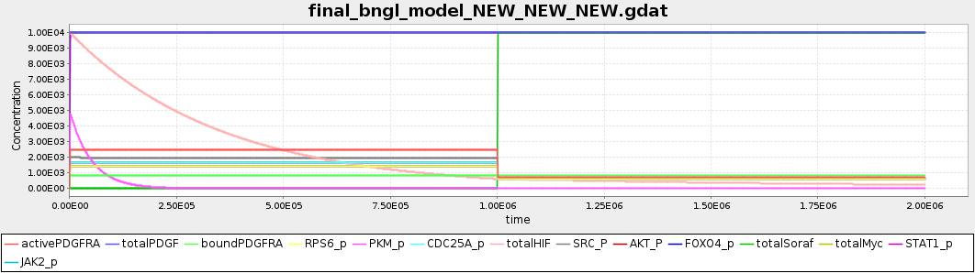
Model still simulatable as ODE network This allows for traditional parameter estimation

Slide 28
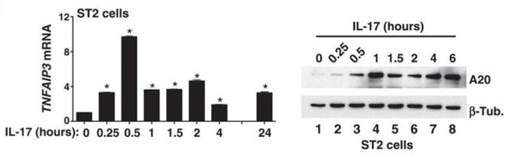
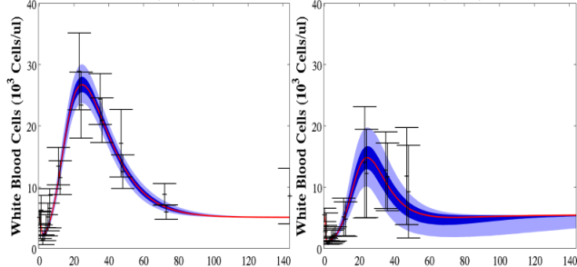
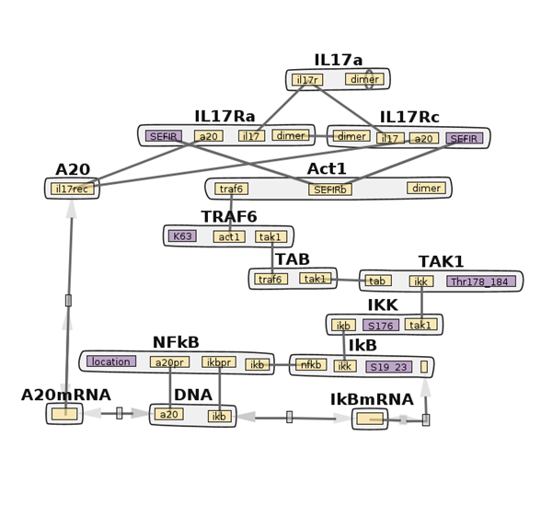
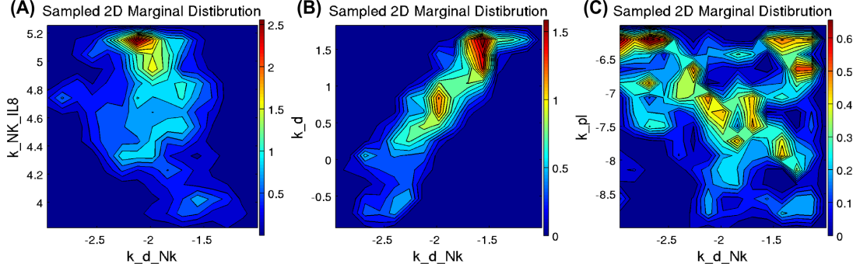
Fitting to experimental data: parallel tempering
Bulk Experimental Data
PTempEst
Best fit parameter ensembles
Parallel tempering for Bayesian parameter estimation of dynamical systems
BioNetGen Model
28
Notes:
28

Slide 29
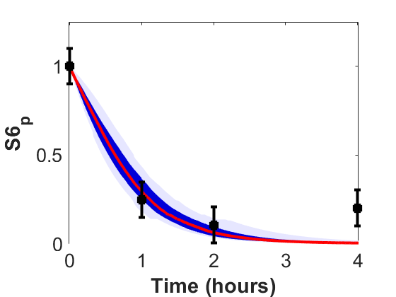
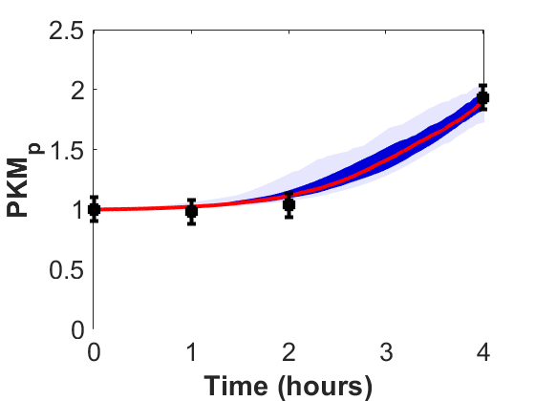
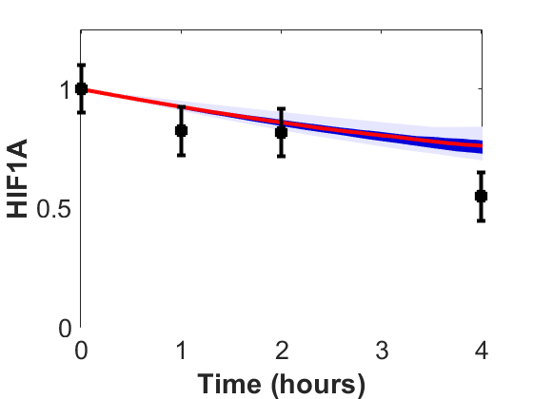
Parameter estimation leads to a quantitatively accurate model

Slide 30
GO Enrichment for metabolic and amino acid synthesis pathways following Sorafenib treatment

Slide 31
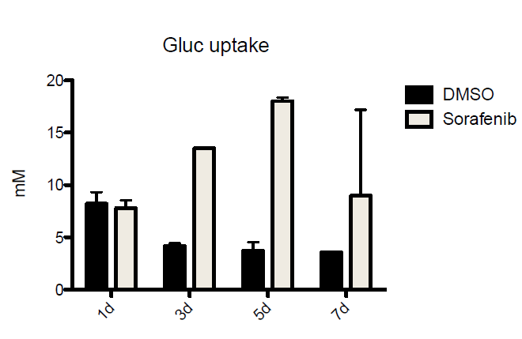
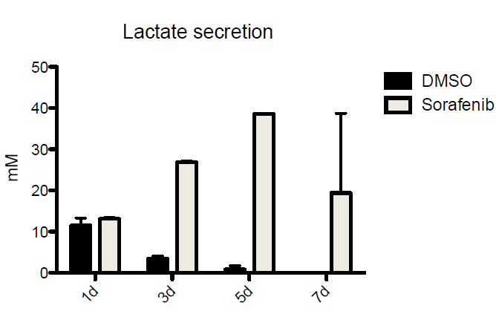
Sorafenib, but not Sunitinib, has an effect on glycolysis
Cell cycle
Glycolysis
Control Sorafenib Sunitinib
Courtesy of Huan Wang

Slide 32
Why does Sorafenib induce glycolysis ?
Amino acid metabolism and Glycolysis
Serine:
Chaneton, Barbara, et al. 2012. “Serine Is a Natural Ligand and Allosteric Activator of Pyruvate Kinase M2.” Nature 491 (7424): 458–62.
Yang, Weiwei, et al. 2012. “ERK1/2-Dependent Phosphorylation and Nuclear Translocation of PKM2 Promotes the Warburg Effect.” Nature Cell Biology 14 (12): 1295–1304.
Hitosugi, Taro, et al. 2009. “Tyrosine Phosphorylation Inhibits PKM2 to Promote the Warburg Effect and Tumor Growth.” Science Signaling 2 (97): ra73.
Courtesy of Huan Wang

Slide 33
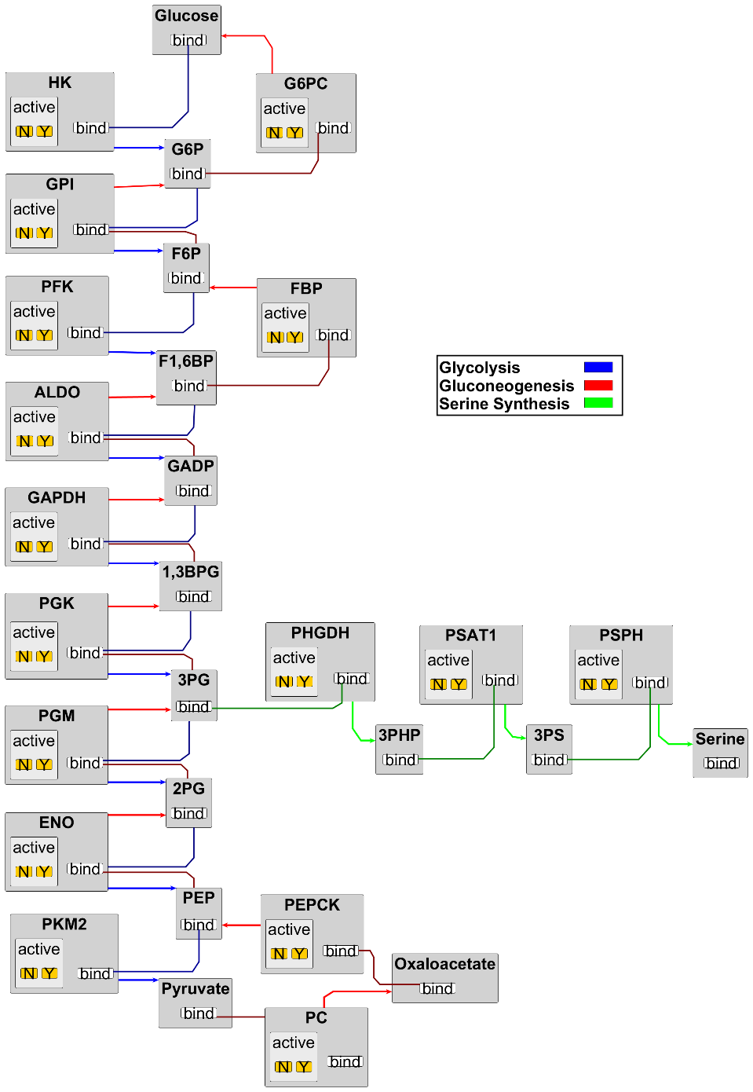
Manually build model of glycolysis and serine synthesis

Slide 34
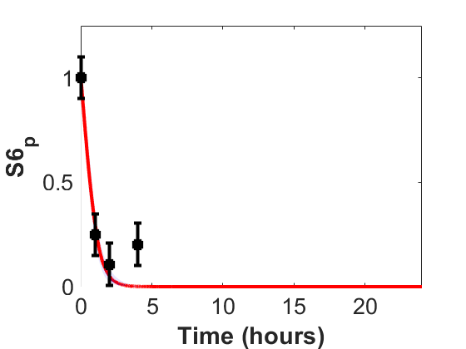
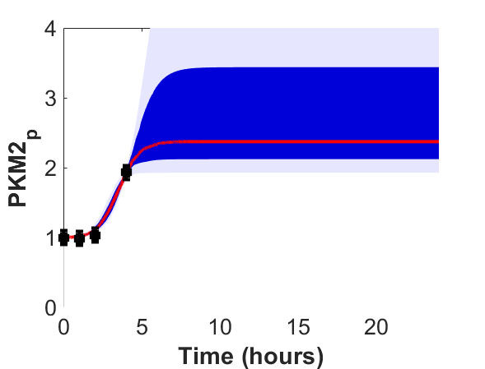
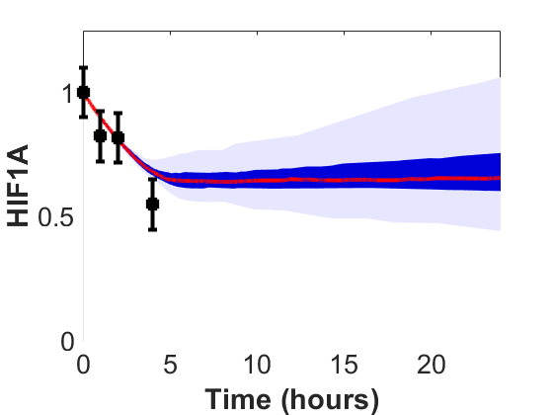
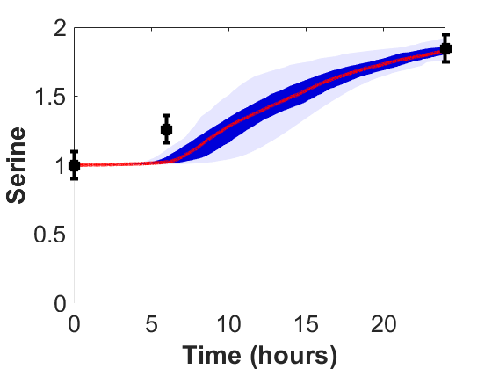
Can fit extended model to signaling and metabolomics data

Slide 35
Conclusions and next steps
We can build a minimal model of drug activity guided by experimental data
One model can match all observations
Can be easily extended to pathways of interest – glycolysis
Finalizing a model for Sorafenib treatment of cardiomyocytes
Select final experimental results to use as model checking criteria
Incorporate metabolomics data
Model calibration
Parallel tempering on population-average data is ready to go
Integrate methods to leverage single cell data – allow for different subpopulations

Slide 36



Acknowledgments
Peter Sorger
Laura Maliszewski
Isabel Latorre
Experimental Work:
Huan Wang
Jia-Ren Lin
Zoltan Maliga
Connor Jacobson
Clarence Yapp
INDRA Team:
Benjamin Gyori
John Bachman
Patrick Greene

Slide 37
Model calibration data: plate-based CycIF
Acute effect study: Short term-treatment ( 1 – 24 hours)
3-point serial dilutions (technical duplicates, 1 plate per timepoint)
1, 3.16, 10 µM: Afatinib, Dasatinib, Gefitinib, Lapatinib, Nilotinib, Sorafenib, Sunitinib
0.1, 0.316, 1 µM: Crizotinib, Ponatinib
Chronic effect study: Long-term treatment (1 - 5 days)
2 concentrations (technical triplicates, 1 plate per timepoint)
1, 3.16 µM: Afatinib, Dasatinib, Gefitinib, Lapatinib, Nilotinib, Sorafenib, Sunitinib
0.1, 0.316 µM: Crizotinib, Ponatinib
Recovery
3 days
In 96 well
1 day
Low serum
1 day
Drug
treatment
At drug treatment timepoints : 1, 2, 3, 5 days
Mitotracker stain (10 min)
PFA fixation (30 min), Triton-X100 permeabilize (20 min)
Block at 4˚ (overnight), stain for DNA, Image 4 fields/well
Connor Jacobson and Zoltan Maliga
Notes:
37

Slide 38
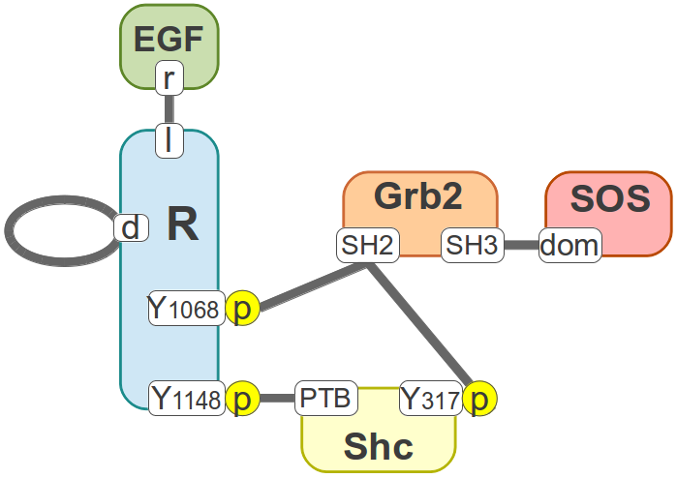
Additional concerns for model scale: combinatorial complexity
Small number of molecular interactions
2×4×6 = 48 monomers
24×25/2 = 300 dimers*
This rule set with 20 rules generates a network with 356 species and 3749 reactions.

Slide 39
Decreasing combinatorial complexity
ACTION: generate_network()
Iteration 0:
15 species 0 rxns
Iteration 1:
36 species 25 rxns
Iteration 2:
244 species 360 rxns
Iteration 3:
35495 species 51422 rxns
Focus on subset on mechanisms
Minimal model
Enforcing rule context
Signaling cascade logic
Require activation step for every protein
Limit PTM sites
Coarse graining
Oligomers
cycle finding/breaking

Slide 40


Coarse-graining like phosphorylation sites vastly reduced model complexity

Slide 41
Coarse-graining like phosphorylation sites vastly reduced model complexity
Iteration 11: 203 species 4259 rxns 1.55e+00 CPU s
CPU TIME: total 12.72 s.
Iteration 9: 33 species 150 rxns 1.00e-02 CPU s
CPU TIME: total 0.23 s.

Slide 42


Can’t always fit an elephant

Slide 43

Adding in negative feedback mechanisms produces a more accurate model

Slide 44

Model can now fit data across doses and cell lines

Slide 45


Incorporating single-cell data: Mechanistic hierarchical population model
Loos, et al. 2017

